Slide 1
Performance modelling of skewed demand in complex systems
Stephen Shephard
School of Computing Science, Newcastle University, Newcastle upon Tyne, NE1 7RU
s.shephard2@newcastle.ac.uk

Slide 2
Introduction
On-line Transaction Processing applications often have skewed demand for some resources
Overloading the whole system affects:
- reputation
- revenue
Cloud technologies may maintain throughput to low demand resources

Slide 3
Motivation
High profile total outages with skewed demand
- London 2012 Olympic tickets website
- HBO Go “True Detective” finale
- Apple iTunes iPhone 7 launch
Notes:
Real world examples of skewed demand

Slide 4
Outline
Background Information – Use Case
Technologies
Modelling
Methods
Systems
Testing
Results
Conclusions & Future Work

Slide 5
Background Information
Use Case: multi-tier ticketing
Web Server 1
Worker
Data
Application 1
Node 1
Web Server 2
Worker
Data
HTTP Load
Application 2
Node 2
Balancer
Middleware
DB Engine
...
...
...
Web Server
Worker
Data
m
Application
n
Node
p
Notes:
Multi-sport event ticketing application using a distributed architecture. Users access the application with a web-based front end. Tickets are stored in one or more databases. In between the web servers and database are worker applications that service user requests, connected to the web servers by some middleware.
It is assumed that there will be predictable skewed demand for athletics tickets.

Slide 6
Technologies
Adapting to demand
Elastic scaling
Sharing demand
Content-blind HTTP load-balancing
Shared middleware
Isolating demand
Content-aware HTTP load balancing
Distributed databases
Microservices

Slide 7
Middleware
Decouple web server/worker application demand
Web Server 1
Worker
Application 1
Web Server 2
Point
-
to
-
Worker
point Queue
Application 2
...
...
Web Server
Worker
m
Application
n

Slide 8
Distributed Databases
Athletics
Archery
Cycling
Judo
Diving
Fencing

Slide 9
Distributed Databases
Athletics
Archery
Archery
Cycling
Judo
Athletics
Judo
Diving
Fencing
Cycling
Fencing
Diving

Slide 10
Microservices
Isolate demand from worker to data node
Web Server 1
Search
Web Server 1
REST API
Search
DB
e
Web Server 2
n
Web Server 2
a
HTTP Load
Book
l
Book
p
k
Balancer
DB
c
a
B
...
...
Web Server
Web Server
Return
Return
m
m
DB

Slide 11
Modelling
Why model?
- Demand is moved, not eliminated
- How do demand manipulations combine?
- Where do the bottlenecks move to?
Models make predictions for complex systems

Slide 12
Modelling
Process Algebra
CloudSim
// Create one virtual machine vmlist = new ArrayList<Vm>();
// VM description int vmid = 0; int mips = 1000; long size = 10000; // image size (MB) int ram = 512; // vm memory (MB) long bw = 1000; int pesNumber = 1; // number of cpus String vmm = "Xen"; // VMM name
// create VM Vm vm = new Vm(vmid, brokerId, mips, pesNumber, ram, bw, size, vmm, new CloudletSchedulerTimeShared());

Slide 13
Methods
Produce simple technology component models in PEPA
Compose into system models
Simple Microservices
Shared Queue and Distributed Database
Shared Queue and Distributed Database with Replication
Experiment with models using PEPA Eclipse plugin
Test model results against actual built systems

Slide 14
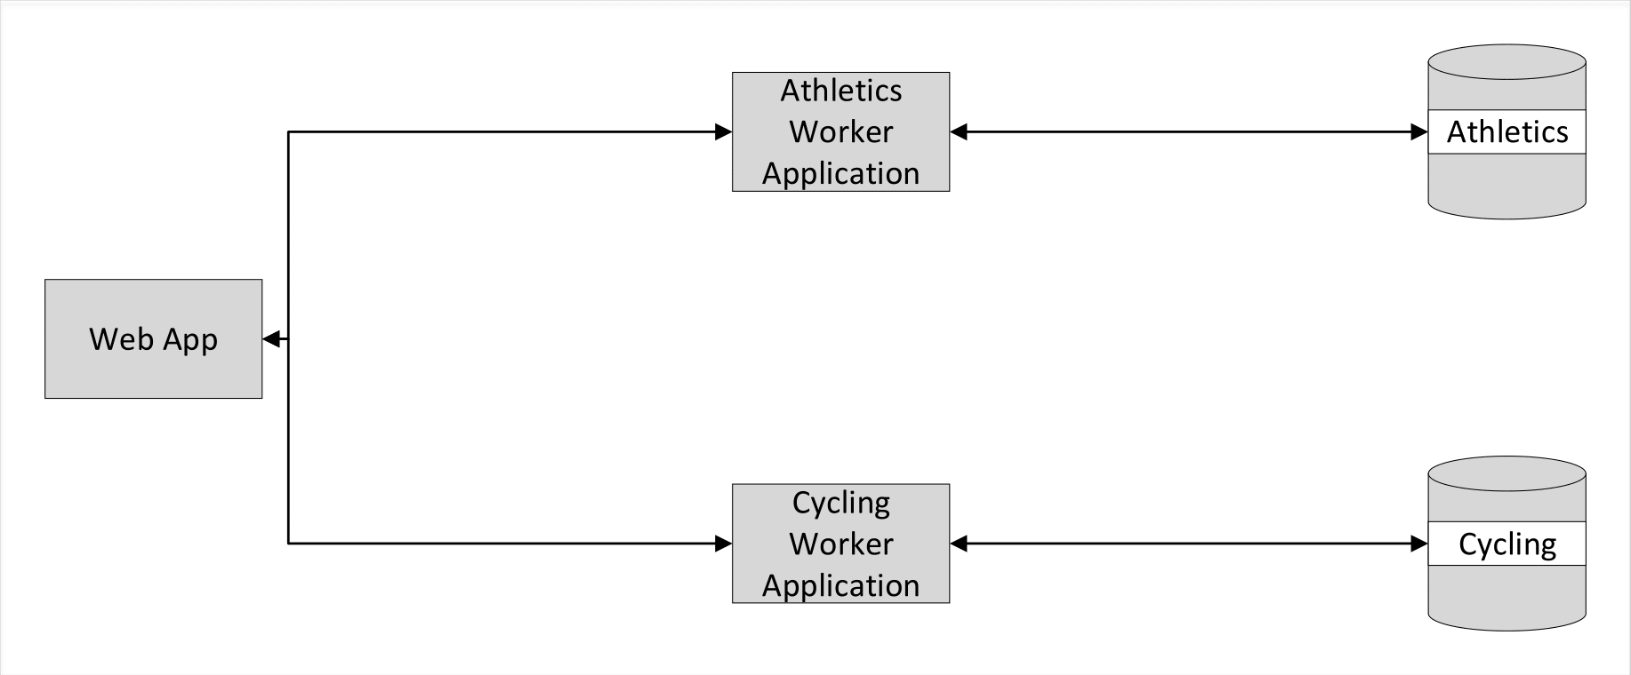
Systems
Simple microservices

Slide 15
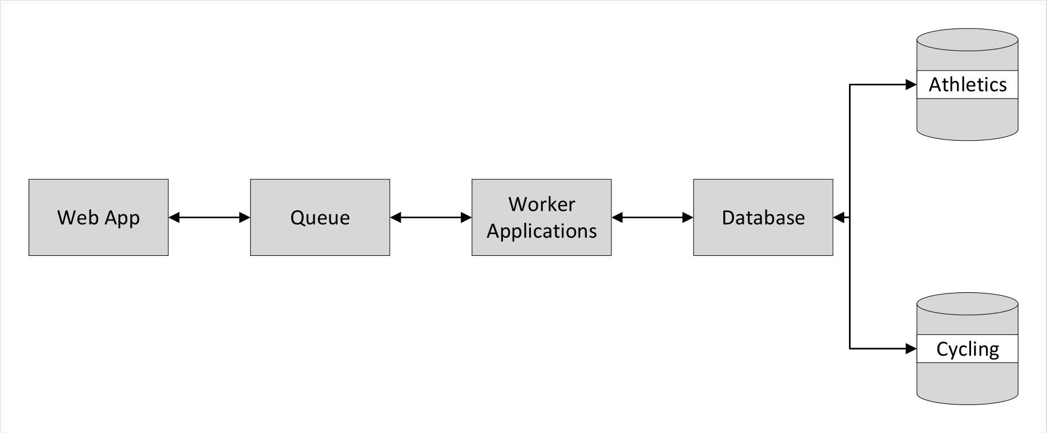
Systems
Shared Queue and Distributed Database

Slide 16
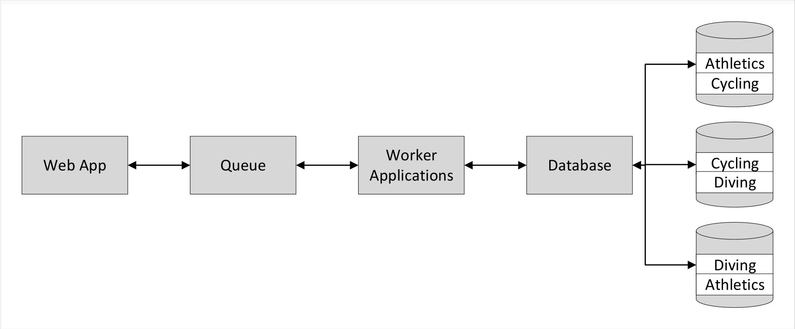
Systems
Shared Queue and Distributed Database with Replication

Slide 17
System Model
Shared Queue and Distributed Database
(animation of PEPA model, composing queue and distributed DB?)

Slide 18
Model Experimental Results

Slide 19
Testing
Build systems in Microsoft Azure cloud
Java and Java Spring
Cassandra Database
Microsoft Azure Storage Queues
Instrument the systems using CodaHale Metrics
Counts every request, takes a 1-minute rolling average every 10s
Test and measure each system 5 times and average the results
Simulate skewed demand with Apache JMeter test plans

Slide 20
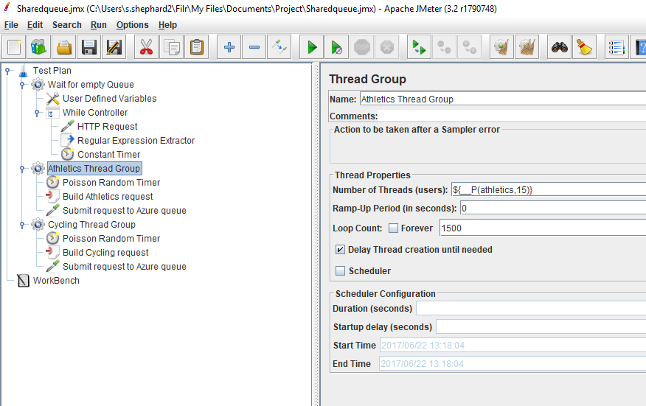
Testing
Apache JMeter test plan

Slide 21
Results

Slide 22
Conclusions

Slide 23
Summary

Slide 24
Future Work

